Slide 1

Meet the Teacher
Welcome to
Year 1

Slide 2
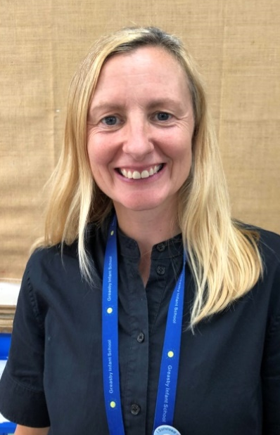

Welcome to
Year 1
Woodpeckers!
Mrs Clark has been at Greasby Infant School for the last ten years, in Year 1 and teaching MFL. She feels blessed to know the children already and can’t wait to teach them in Year 1.
Miss Dunne is excited to be starting teaching at our school. She is looking forward to getting to know the children and finding out what they like learning about.

Slide 3
Who are we?
We aim to provide a happy, relaxed environment where children are encouraged and supported to achieve their full potential and to develop an attitude of care and responsibility towards others and their surroundings.
We ensure that the children in this school will attain the highest standards of which they are capable. We encourage the children to be independent and self-confident and we believe that this can be achieved more readily when teachers, parents and pupils work together in partnership.

Slide 4

School Rules
This year we have taken on our new school rules –
Ready, Respectful, Safe
Ready – Correct uniform, reading book, listening, lining up
Respect – For our school community and our environment
Safe – Looking after each other, online safety, stranger danger

Slide 5
Topic outline for this year will be:
In addition to daily phonics, literacy and Maths your children will be enjoying their topic lessons.
Autumn – Humans & Materials (Science)
Local Geography & Grandparents’ Toys (Geography & History)
Music, Computers, PE, Art, DT & MFL (Spanish & Chinese)
Spring – Seasonal Changes & Animals (Science)
UK & Weather & Past Technology (Geography & History)
Music, Computers, PE, Art, DT & MFL (Spanish & Chinese)
Summer – Plants & Trees (Science)
Features of Hot & Cold places & Famous Person (Geography & History)
Music, Computers, PE, Art, DT & MFL (Spanish & Chinese)
Curriculum overviews for each half term will be on the class page on the school website. The link to this will be sent out each half term alongside any key information and PE days.

Slide 6
Trips
In Year 1 we try and visit locations that fit with our curriculum.
Past visits have included Eureka!, Knowsley Safari Park and Church Farm.
We will inform you about local visits (e.g. church) as well. Walkers are always needed so please let us know if you can help!

Slide 7
PE will usually be on :
Wednesdays this half term
Your child will need the following items named:
White t-shirt, black shorts (and jogging bottoms), trainers (for outside PE), pumps (for indoor PE). Please can they also wear a school jumper/cardigan.
Children to come in to school on PE days in their PE Kit.
Sports Club Days – if it is not their PE day children need to bring their kit in to get changed into after school.

Slide 8
HOMEWORK
An overview for the homework for the half term, with the weekly expectations, will be on the class page on the website.
In addition to this, star word spellings will be sent home on alternate Fridays. Additional sheets can be found on the website for anyone who requires a little extra.
Children to bring back their homework books on a Wednesday. Over the half term teachers will look through.

Slide 9


Reading in year 1.
Each child is expected to ‘Strive for five’ – this means reading at least 5 times a week at home.
All children will bring home two books to read, their Read Write Inc phonic book plus an additional book (either RWI or from our Bug Club books – linked to Phonics group)
Please bring these books back on Thursdays when they will be changed.

Slide 10
Water Bottles
Please make sure that these are named – water or sugar free cordials/squash only. No fizzy drinks please. Drinks will be stored and children will have regular access to them at appropriate times.
School Bags
Please bring these in each day and check them each night. We know the children love to adorn them with key rings, but please limit this to one small keyring as space in their drawers is limited.
Label
Please label clothes (especially jumpers).
Personal Items
Please encourage your child to leave all personal items at home as we would not like anything precious to be lost at school.
Snacks
Fruit is available for snack at break time.
School Meals
The menu is available, please discuss the choices with your child so they are familiar with their choices. We will endeavour to let you know any changes ahead of the day. Year 1 and 2 will make their choices on the day.
PLEASE REMEMBER WE ARE A NUT FREE SCHOOL DUE TO ALLERGIES.

Slide 11
Friday Assembly
Each week we will pick two of our children to receive an award for a special achievement that week – one linked to our curriculum and learning and another for a child that has ‘shone bright’ that week.
Parents will be informed on the Wednesday and can attend the assembly on a Friday at 2:40pm.
The children who receive a certificate will have a hot chocolate and time to share their learning the following week with Mrs Grimster or Mrs Cooper.
Personal trophies and medals will be shared on a Friday in class.

Slide 12
Time off school
In case of illness: phone school office before 9.30am
Requested time off school: please email the school office to explain why it is exceptional. A leaflet explaining fixed penalty notices has been sent out in July regarding new rules.
We are expected to issue Fixed Penalty Notices for more than 10 sessions (1 day = 2 sessions) of unauthorised absence in a ten week period.
We do monitor late arrivals and those who have regular time off school and will be in touch where necessary to offer support.
The gate opens at 8.40am and closes at 8.55am. There are learning activities in classrooms from 8.40am so please ensure a prompt arrival.

Slide 13
Communication and Progress
As a school we want to keep parents and carers up-to-date with their child’s education and what is happening in school.
All information will be sent through E-Schools emails (F2 tapestry???)
At the start of each half term your class teacher will send you a message regarding all information for that half term and the link to the class page for curriculum information
Important Dates poster overview will be sent out each half term
Fortnightly newsletter
A member of staff on the doors every morning to pass important messages to and Mrs Grimster will be on one of the gates too
Follow our Greasby Infant School Facebook page for celebrations of what we have been up to!
Invitation to our praise assembly if your child is receiving one of the certificates. These will be sent on a Wednesday evening for the Friday.
Termly sharing afternoons to attend school from 2pm and share your child’s books with them and talk to them about their learning.
2 Parents Evenings – November and March 3:30-6:00pm.
One end of year report with option for meeting from this if needed.
If the class teacher has any concerns regarding your child’s progress they will arrange a meeting with you to discuss about steps to support them

Slide 14
Questions and Concerns
If you have questions or concerns please let us know so these can be dealt with promptly. Please understand that a teacher or member of staff may not be able to respond on the same day due to their teaching commitments and will not outside of their working hours.
A new home school communication charter is being created to ensure clear and effective partnership between school and families. This will be sent out this half term.
Parental ‘What’s app’ groups are very helpful but please come directly to school staff with questions e.g. Why is my child having a baked potato each day?

Slide 15
Who to speak to at Greasby…
First port of call should always be your child’s teacher.
Headteacher – Mrs Grimster
headteacher@greasby-infant.wirral.sch.uk
Deputy Headteacher – Mrs Cooper
scooper@greasby-infant.wirral.sch.uk
SENCO – Mrs Pollitt
lpollitt@greasby-infant.wirral.sch.uk
School Office
schooloffice@greasby-infant.wirral.sch.uk

Slide 16

FOGIS
Involving yourself with the FOGIS is important.
If you would like to get involved please email
fogis2023@gmail.com
_____
We need your support ~ thank you.

Slide 17
YEAR 1 Phonics Screening
All children at the end of Year 1 (May/June) will do the Phonics Screening Test. The children are unaware they are taking a test when doing it so it is not at all worrying for them.
They need to score around 32 or 33 out of 40 to pass.
If they do not pass it they will retake it in Year 2.
We prepare them for this but your help at home is priceless!

Slide 18



Great Websites :
Spelling Frame
BBC Bitesize
Spell Zone (word lists)
The School Run
(for parents!)
Great Apps :
Squeebles
Hit the Button
Doodle Maths

